Slide 1
Maven
Priyanka Sarode

Slide 2
What is Maven?
Maven is a project management and comprehension tool that provides developers a complete build lifecycle framework. Development team can automate the project's build infrastructure in almost no time as Maven uses a standard directory layout and a default build lifecycle.
In case of multiple development teams environment, Maven can set-up the way to work as per standards in a very short time. As most of the project setups are simple and reusable, Maven makes life of developer easy while creating reports, checks, build and testing automation setups.

Slide 3
What is Maven?
Maven provides developers ways to manage the following −
Builds
Documentation
Reporting
Dependencies
SCMs
Releases
Distribution
Mailing list
To summarize, Maven simplifies and standardizes the project build process. It handles compilation, distribution, documentation, team collaboration and other tasks seamlessly. Maven increases reusability and takes care of most of the build related tasks.

Slide 4
Understanding Maven
It is a project build tool that comes under the license of Apache, and there are whole hosts of libraries available in the Maven repository.
In a project, getting the right JAR files is a difficult task where there could be conflicts in the versions of the two separate packages. However, It makes sure all the JAR files are present in its repositories and avoid any such conflicting scenario.
To get those JAR files from Maven, we need to visit the Maven repository and search for the exact dependencies, such as the Spring dependency, Hibernate dependency, etc.
Understanding the project is the first and foremost requirement in it. In a Maven project, the file which is of utmost importance is the pom.xml file. Now, based on the dependencies, you need to mention the exact name in this pom.xml file. For example, if you need Hibernate dependencies, you need to specify them within the dependencies tags.

Slide 5
Understanding Maven
After the Project comes to the GroupId. Now, different companies or people build different projects, which highlights the problem of making sure each project is unique. Thus, this problem in uniqueness could be resolved by using a unique ArtifactId or GroupId, which distinguishes one project from another.
This is done by combining ArtifactId, which represents the project name, with GroupId, which describes the package.
For example, let’s say a GroupId is named as com.mypackage, and ArtifactId is named as mavenproj1, then the Package name would be com.mypackage.mavenproj1.web. These things would simplify the Maven process.

Slide 6
Understanding Maven
Maven Repository
Archetype Info
Dependency Info
Development Environment
Directory Structure
Maven
jars
pom.xml
Build

Slide 7
What Maven does?
Maven does lot of things behind the scene, we don’t have to configure each and every step.
Maven achieve : creating a source code directories, configuring the dependencies, compiling and packaging all these Maven does automatically behind the scene.
Maven has done for us is : Project template : We don’t have to create each and every directory, create whole package structure for all these maven automatically created the whole template.
Second thing that Maven does is: Build and Package the application so we were compile package the code into jar file.

Slide 8
Maven archetype
Archetype is a Maven project templating toolkit. An archetype is defined as an original pattern or model from which all other things of the same kind are made. The name fits as we are trying to provide a system that provides a consistent means of generating Maven projects.
Archetype will help authors create Maven project templates for users, and provides users with the means to generate parameterized versions of those project templates.
If user want to standardize J2EE development within your organization, so you may want to provide archetypes for EJBs, or WARs, or for your web services. Once these archetypes are created and deployed in your organization's repository, they are available for use by all developers within your organization.

Slide 9
Maven archetype
To create a new project based on an Archetype, you need to call
mvn archetype:generate
The output of the above step was that have on hard disk with
Folder Structure
pom.xml
These were downloaded from Maven Repository depending on the inputs that we provided.

Slide 10
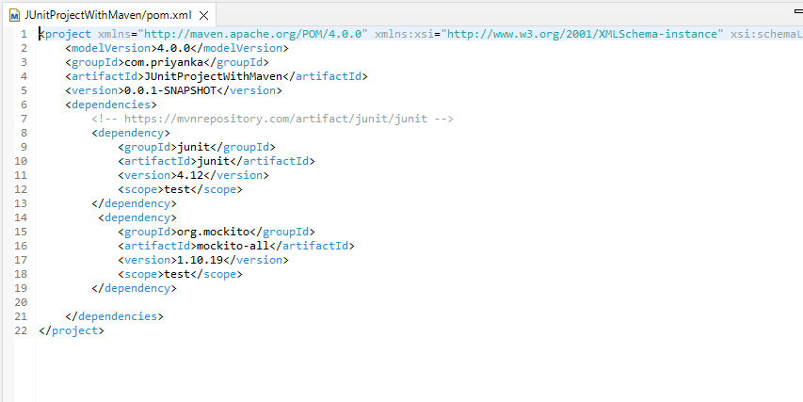
pom.xml

Slide 11
Maven archetype inputs
project-It is the root XML element of POM file.
modelVersion-It is the sub element of project. It specifies the modelVersion. It should be set to 4.0.0.
GroupId-It is name of group or organization of project. It is the sub element of project element.
ArtifactId– It is name of project (~artifact) what we are creating and it is the sub element of project element. An artifact is something that is either produced or used by a project.
version-It specifies the version of the artifact under given group.
Package-The above groupId, artifactId and version elements would result in a JAR file being built and put into the local Maven repository at the following path:

Slide 12
pom.xml
The pom file should be located into the root directory of the project.
Maven co-ordinates : GroupId, ArtifactId, Version
Metadata : about the project
Build Information : packaging information that is War/Ear/Jar.
Resource and dependencies

Slide 13
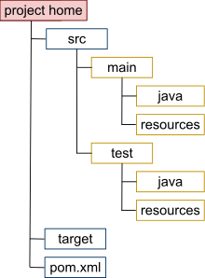
Maven Directory Structure
Maven has own standard for directory structure to create in a project. So we no need specify any directory on the project level for sources, resources, tests, plugins etc. And also we don’t need to configure for creating directory structure on the pom.xml file it is internal functionality of maven.

Slide 14
Directories level on project created by Maven
Source Directory
-src This is src directory which contains two more such as main and test directories inside. The main directory is for your source code and test directory is for test code.
-main Under the main directory there are many more directories such as java, resources, webapps etc.
-java The java directory contains all java codes and packages
-resources The resources directory contains other resources needed by your project. This could be property files used for internationalization of an application, or something else.
-webapp The webapp directory contains your Java web application, if your project is a web application.
-test Under test directory contains two directories such as java and resources.
Target Directory
-target The target directory is created by Maven. It contains all the compiled classes, JAR files etc. produced by Maven. When executing the clean build phase, it is the target directory which is cleaned.

Slide 15
Maven Lifecycle
A Build Lifecycle is a sequence of tasks we used to build a software. For example, compile, test, test more, package and publish or deploy are all tasks we need to do to build a software.
A Maven build lifecycle is a sequence of phases we need to go through in order to finishing building the software.
The following table lists some of the build lifecycle
Lifecycle | Description
validate | validate the project is correct and all necessary information is available
compile | compile the source code
test | test the compiled source code using a unit testing
package | take the compiled code and package it in its distributable format, such as a JAR
integration-test | deploy the package into an environment where integration tests can be run
verify | verify the package is valid and meets quality criteria
install | install the package into the local repository
deploy | publish to integration or release environment

Slide 16
Maven Lifecycle
In maven, there are three independent life cycles, namely clean, default and site.
Clean : the purpose of the clean life cycle is to clean up the project.
Default: the purpose of the default life cycle is to build a project.
Site : the purpose of site life cycle is to establish project site.
Each life cycle contains phases, which are sequential, and the later phases depend on the earlier ones.
For example : Clean : the lifecycle contains following phases pre-clean, clean and post-clean.
pre-clean | executes processes needed prior to the actual project cleaning
clean | remove all files generated by the previous build
post-clean | executes processes needed to finalize the project cleaning

Slide 17
Maven Build : default lifecycle
Build Lifecycle : It is a part of Maven architecture. Every build follows a life cycle. This lifecycle split into different phases.
Compile Phase , Test Phase are the phases of Build Lifecycle.
If user not specified the phases explicitly Build Lifecycle sets as Default Build Lifecycle.
Some of the phases have default behavior : Compile-takes the code from main directory and compile. Test-takes the code from test folder to check the test cases.
Specify the build phase you need. Previous phases automatically run.
Compile
Test
Package

Slide 18
Default Lifecycle
Validate : configuration is proper, checks the order, pom is in its place.
Compile : takes java file and converts it into class file.
Test : where test cases are executed.
Package : packaging the code and generated the artefacts.
Install : installs that package the artefact into a local Maven repository. It helps to publish your jars into local repository.
Deploy : publishing the artefacts to remote repositories where other users can download

Slide 19
Practical Demo
Maven With Eclipse IDE

Slide 20
Thank You
Priyanka Sarode

